Slide 1

& the Learning Health System
bit.ly/smart-fhir-tech
@JoshCMandel, MD
Microsoft Healthcare / SMART Health IT
FHIR STARTER 2019, Saint Petersburg
Notes:
These slides are available online -- bit.ly/smart-fhir-tech has a link
There is so much activity right now to improve and expand the FHIR specifications; and in developing regional Implementation guides; and in building software systems that support FHIR.
In this talk I want to provide a framework for thinking about how these efforts fit together -- it's not the only framework but it's one I rely on internally when I want to assess the role to any given project.

Slide 2
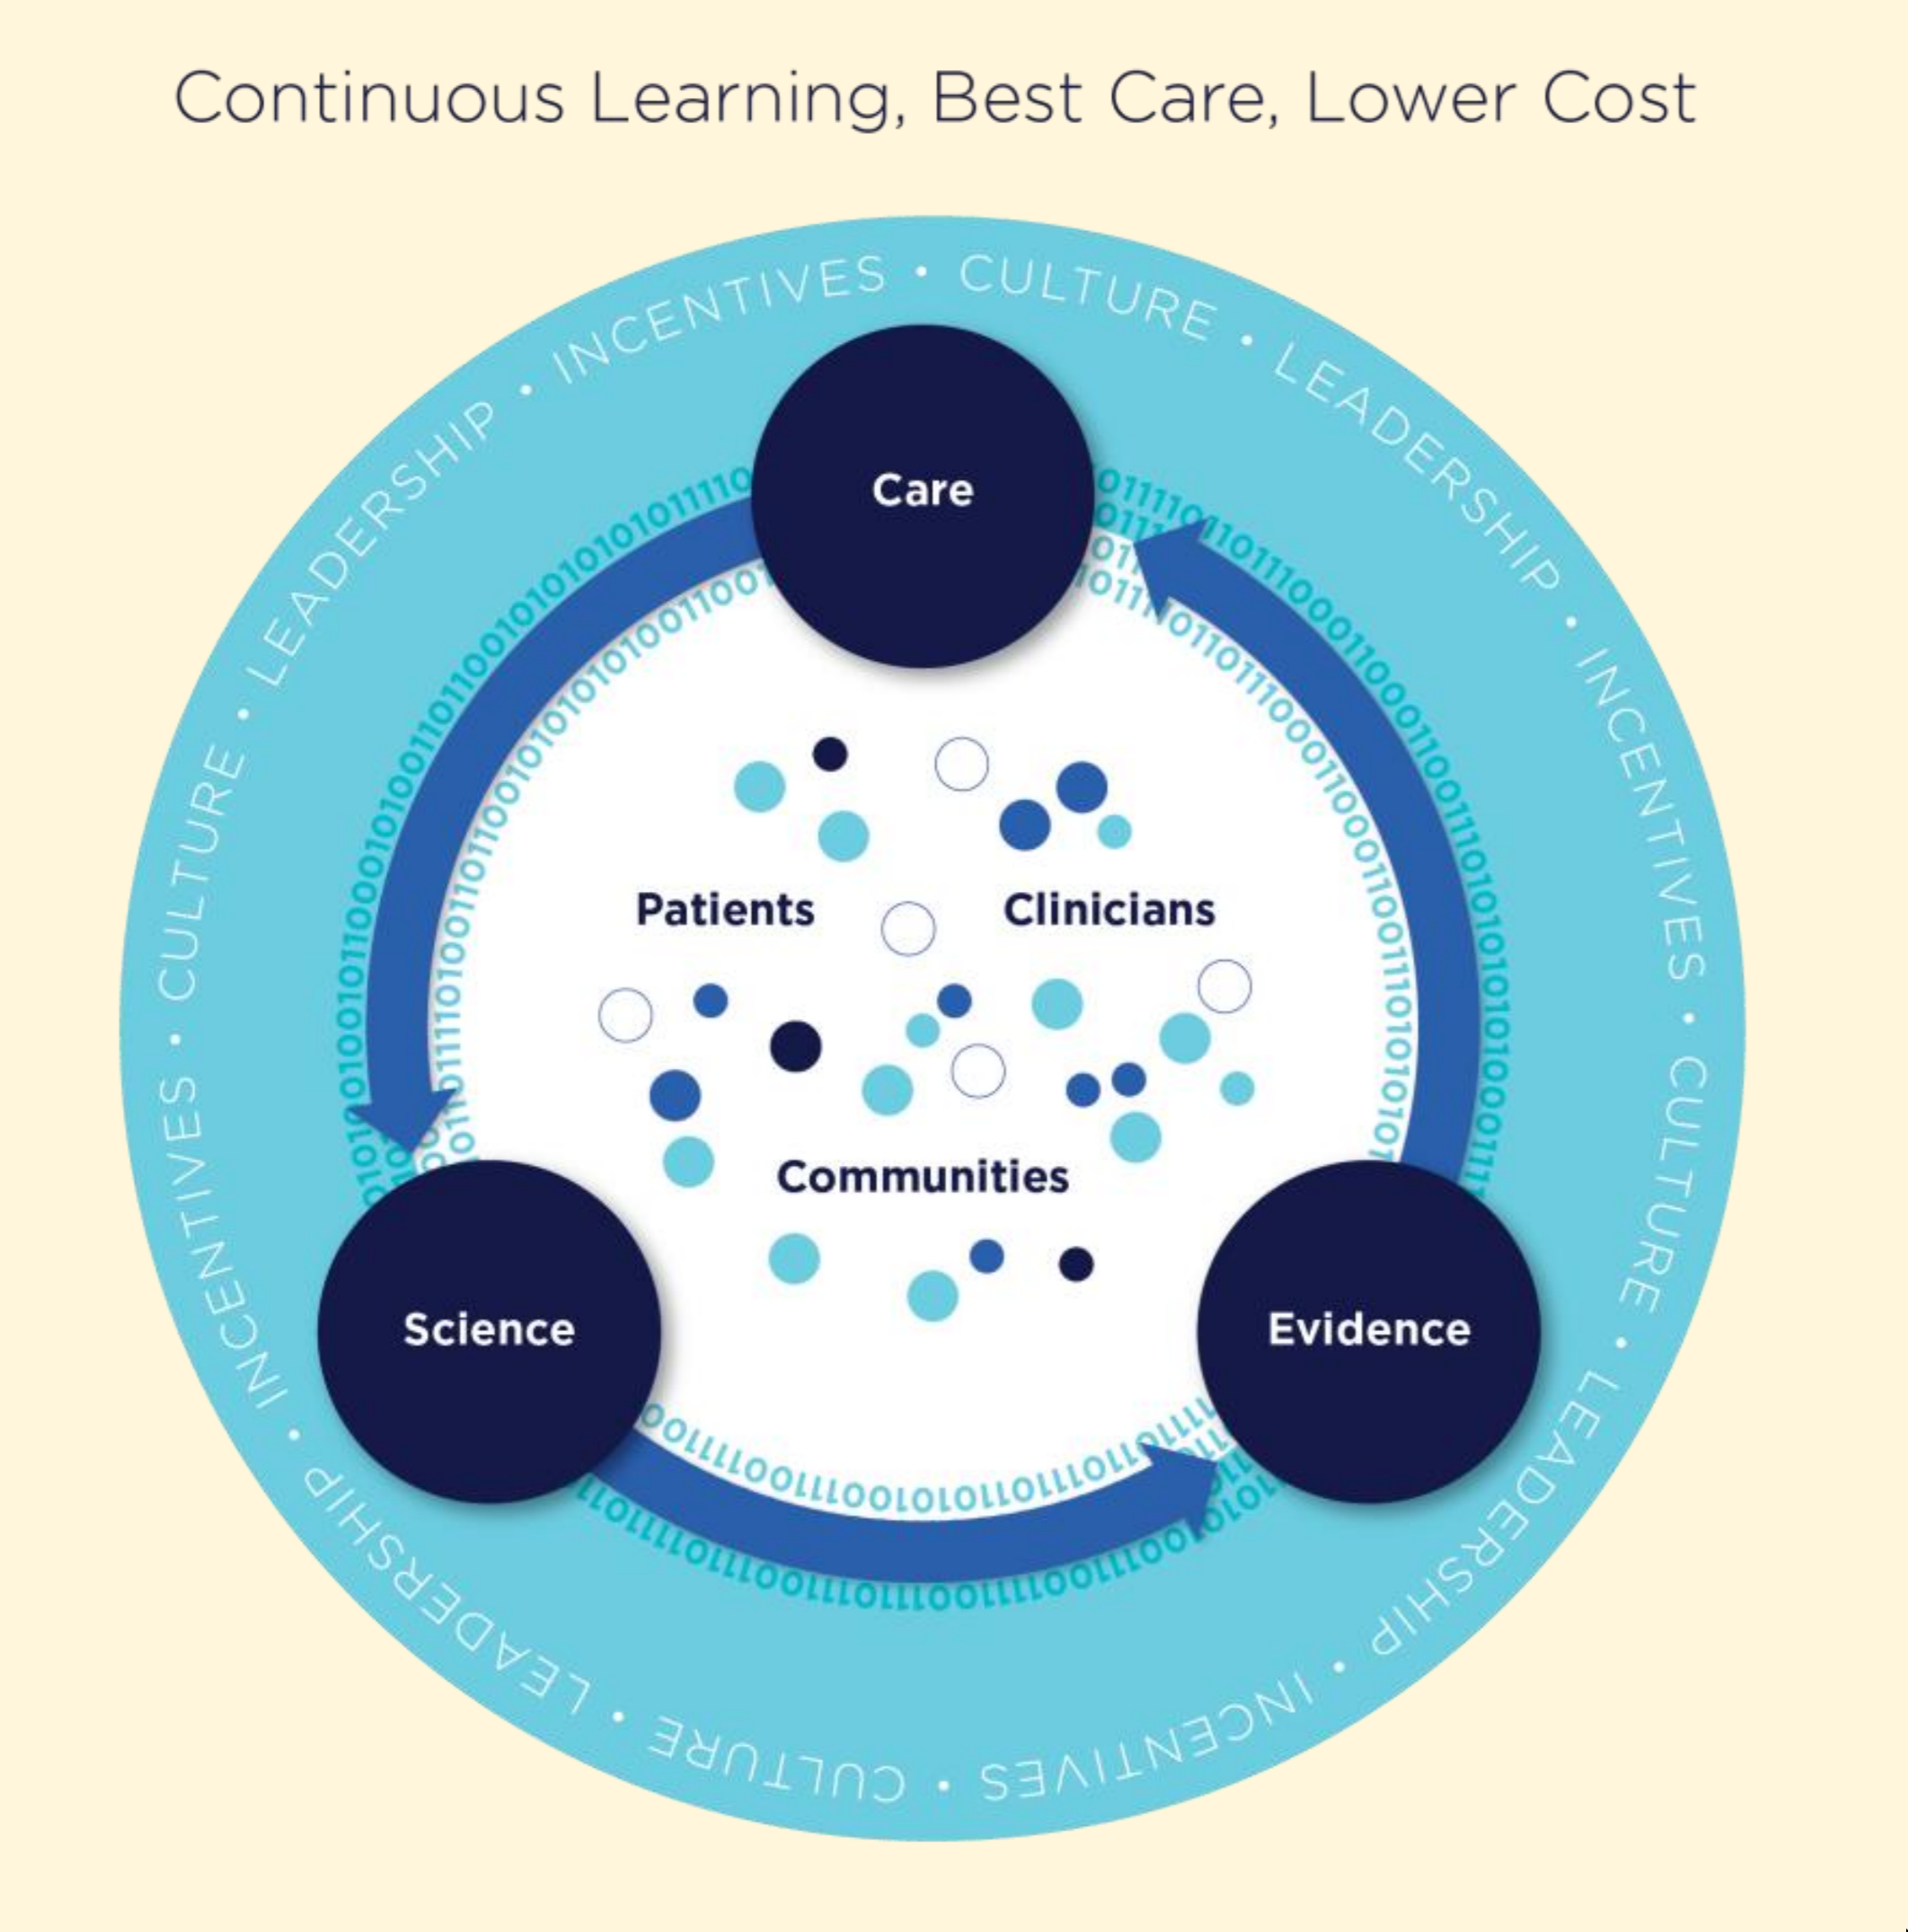
Institute of Medicine: Learning Health Perspective
http://www.nationalacademies.org/hmd/~/media/Files/Activity%20Files/Quality/LearningHealthCare/Release%20Slides.pdf
Notes:
This vision goes back to a 2007 report from the National Academy (it was called the Institute of Medicine, back then). And there are various other formulations --- sometimes the circle runs clockwise, instead of counterclockwise…
but the point is that there is a kind of virtuous cycle. There is a feedback loop driven by overlapping communities (patients, providers, researchers, public health, government/policy makers) -- where clinical care is driven by evidence, and care leads to the generating of data that in turn contributes to the total evidence base, through a scientific process.

Slide 3
Zooming into "Care"
Choose a provider
Where can I go?
How much does a visit cost?
What does "quality" look like?
Diagnostic Journey
Bring my history with me
Develop a differential diagnosis
Narrow down hypotheses
Treatment
Shared decisions
What do "patients like me" choose, and what are the outcomes?
Trade off between benefits, costs (not just financial, but side effects, etc)
Notes:
Convenience features *and* a way to incorporate evidence (effectiveness, cost) into the workflow

Slide 4
"Care" process generates reams of data
Consumer web and search history
Scheduling and location
Clinical point-of-care data (observations, plans, notes)
Laboratory data (local + reference labs)
Imaging data
Survey, self-reported data
Activity, fitness, and "device" data
→ Over time, these translate to outcomes

Slide 5
Making (shared) clinical decisions
Notes:
Almost every clinical decision comes down to a matter of preferences, though we don't always present it this way to patients. If you really dig into the evidence today, almost nothing is black and white. Treatments known to have an advantage at the population level might not be the best choice for any individual. And most of our studies result in coarse grained recommendations.

Slide 6
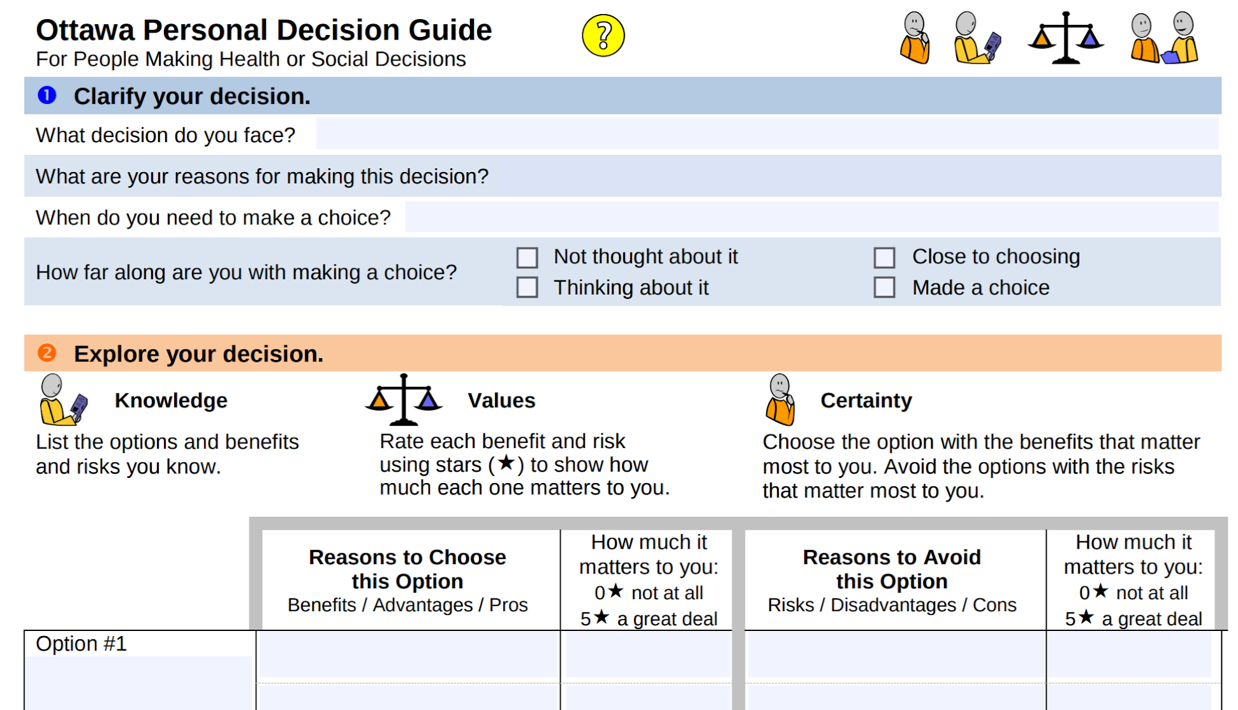
https://decisionaid.ohri.ca/decguide.html
Notes:
So, how do we weigh options and drive better decisions? This form comes from the Ottawa Personal Decision Guide. It's from the late 1990s, and it captures a generic process for comparing options, and for understanding a patient's preference for decision making (e.g., do you prefer to take an active role?)
And there's good evidence that using even a very basic framework like this helps lead to better quality decisions -- and patients who feel more satisfied that they've made the right choice.
This is so simple, but already very powerful.

Slide 7
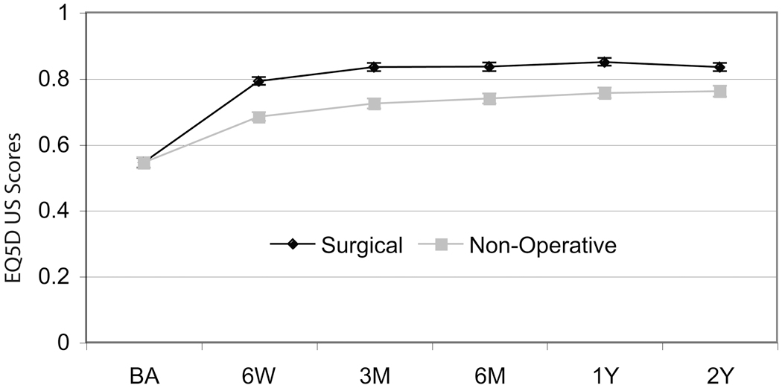
Decisions in spine surgery (SPORT)
https://www.ncbi.nlm.nih.gov/pmc/articles/PMC2883775/
Notes:
Now let's look at a more focused example, guiding a very specific decisions about whether to have spine surgery for specific problems like spinal stenosis, where the space for the spinal canal gets too narrow.
The first critical component for decision making is outcome data -- and ideally through high quality evidence like a randomized controlled trial. SPORT is a set of trials entirely focused on generating this kind of high quality evidence.
The graph here shows EQ-5D scores -- this is a generic measure of Health status across five domains (mobility, self-care, usual activities, pain/discomfort, and anxiety/depression). The important points here are:
Both groups improve with treatment
Outcomes from surgery are better, but only marginally
Outcomes converged over time

Slide 8
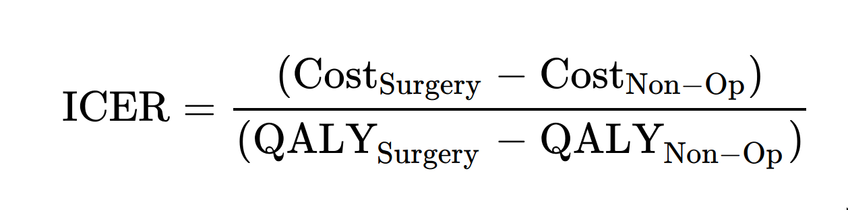
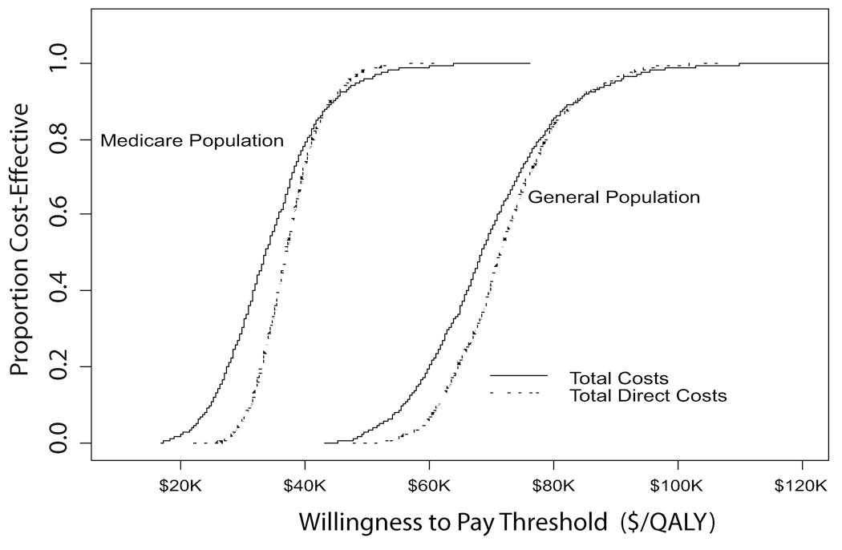
Decisions in spine surgery (SPORT)
"Incremental Cost-Effectiveness Ratio"
https://www.ncbi.nlm.nih.gov/pmc/articles/PMC2883775/
Notes:
These kinds of studies provide information not just about outcomes, but about public policy, too. For example you can translate outcome improvements into economic terms (never easy , always an approximation, but this is how we decide what's worth spending our share resources on).
This approach can tell you how much it's "worth" spending on a particular intervention, at the population level.

Slide 9
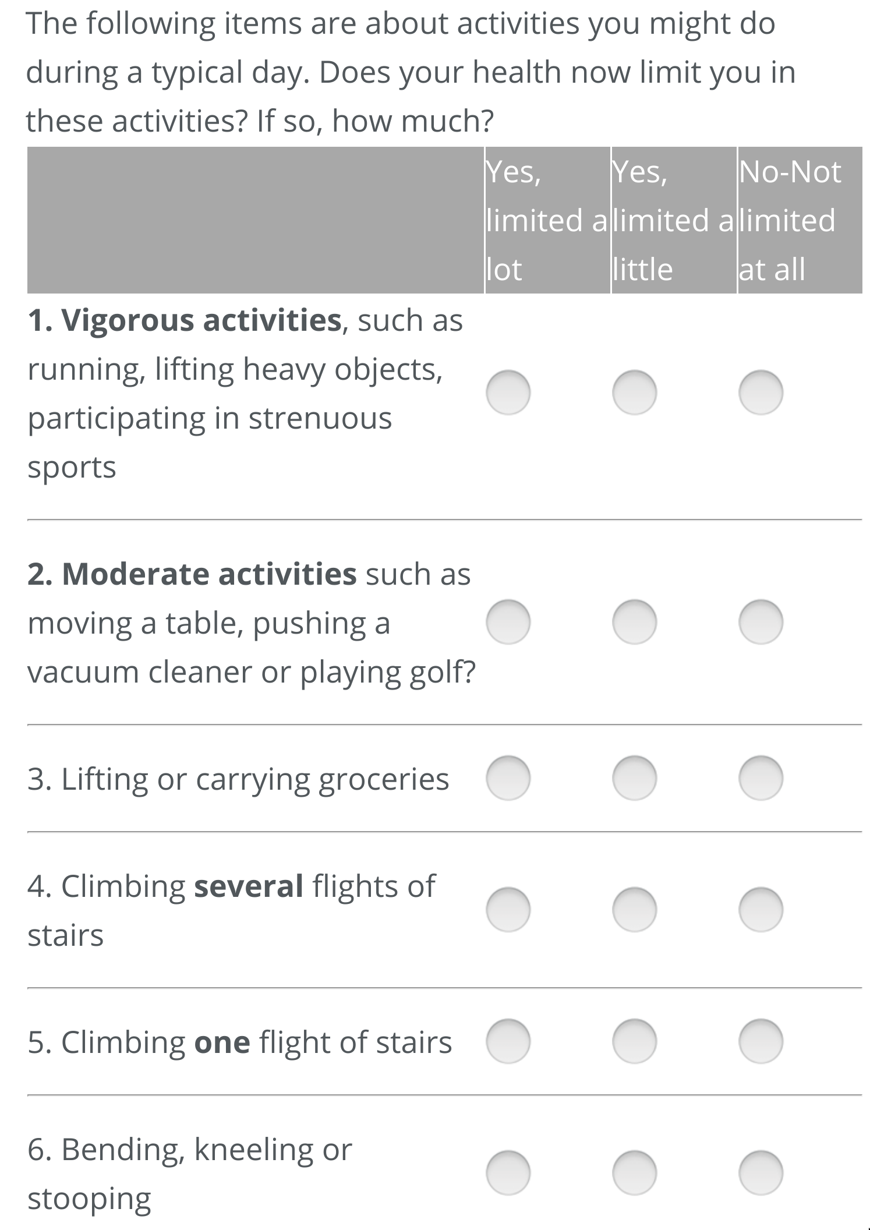
Example of a focused decision aid (SPORT)
spinesurgerycalc.dartmouth.edu
Notes:
With this kind of evidence in hand, you can build much more tailored tools that enable shared decision-making. For example, SPORT data are used to Power this web based tool that gathers a patient's history and preferences...

Slide 10
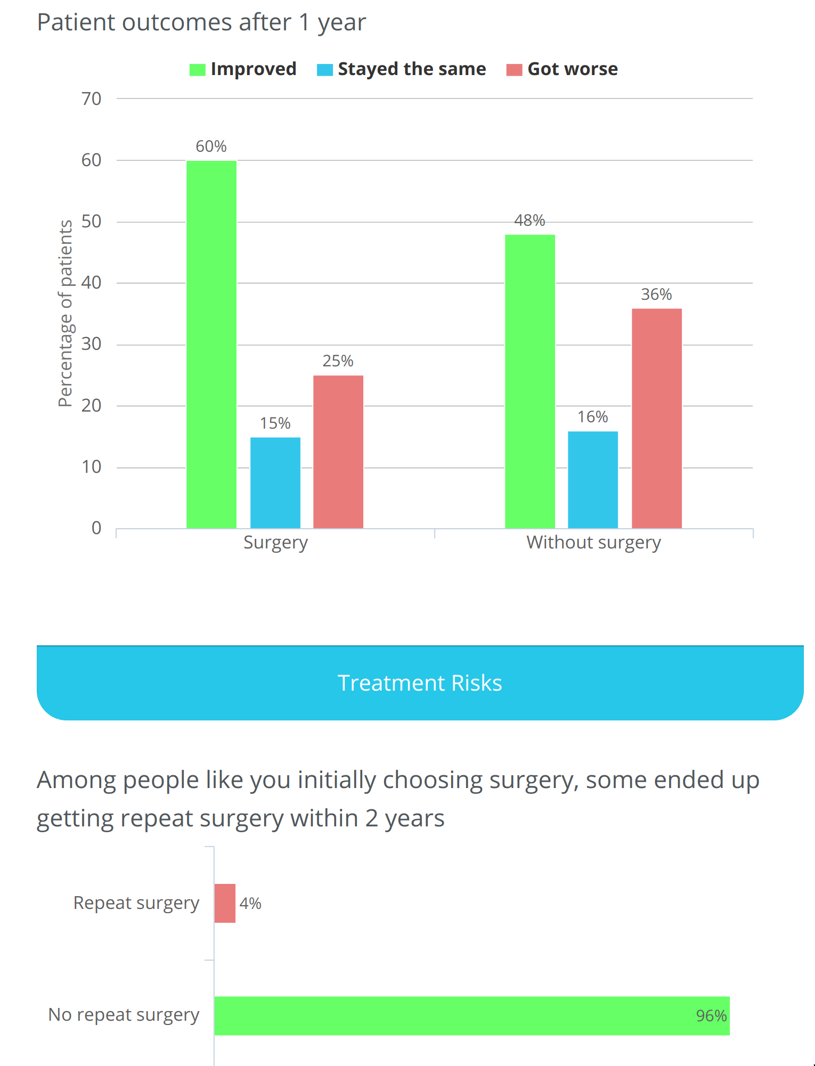
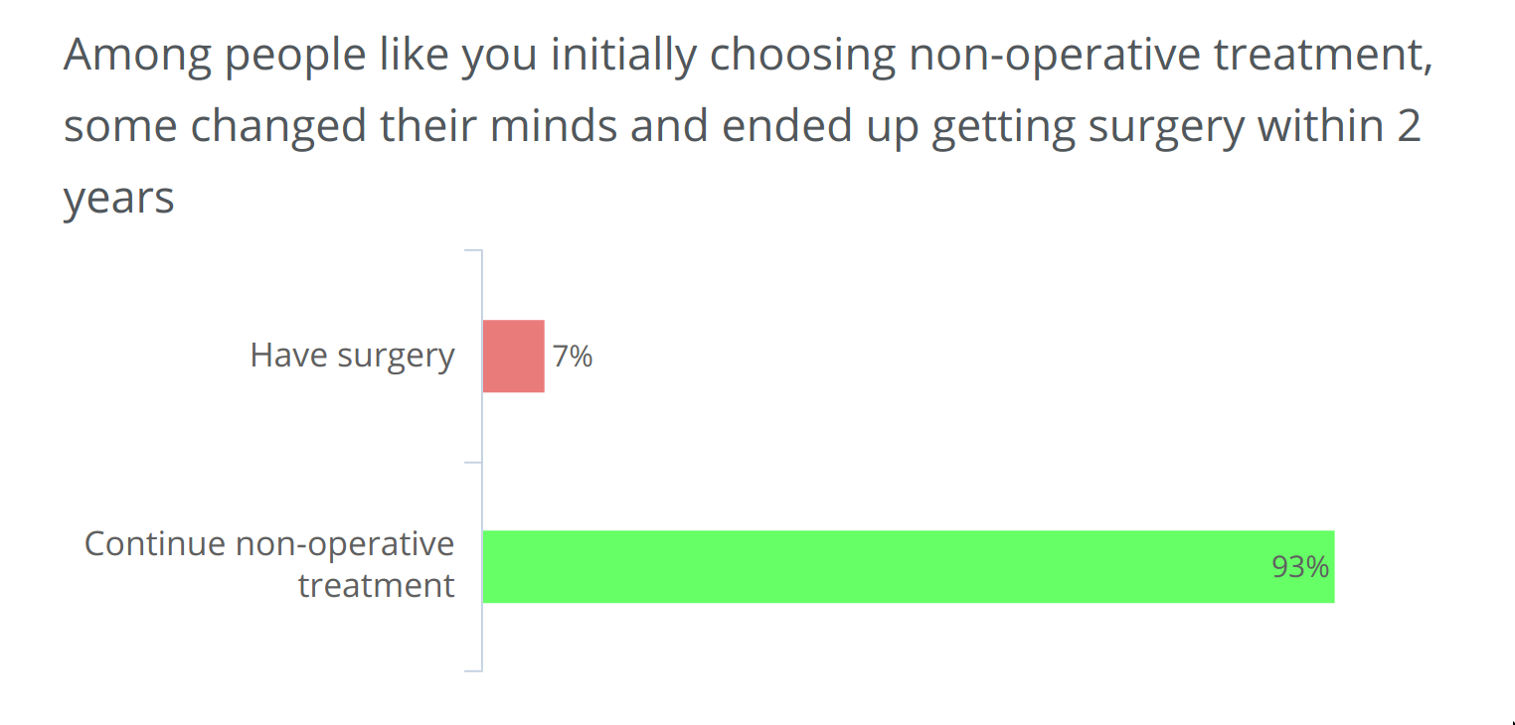
Example of a focused decision aid (SPORT)
spinesurgerycalc.dartmouth.edu
Notes:
And thwen produces patient specific outcome predictions.

Slide 11
How does it scale?
Notes:
This approach is very effective, generating good evidence -- but it took about ten years and about twenty million dollars to complete this kind of work.
Continuing to support these kind of high quality studies is critical -- but at the same time, we need to get much better at deriving conclusions from "routine" clinical data. This is where the learning health goals come until play.

Slide 12
How can we bring FHIR to the table?
Reviewing three key technologies
Bulk Data
SMART on FHIR
CDS Hooks

Slide 13
An ecosystem of FHIR and related technologies
NLP: clinical notes → FHIR
FHIR-based personal records
FHIR Appointments
SMART on FHIR
Bulk Data
CQL, Quality Measures
FHIR Subscription (public health)
(disease registries)
SMART on FHIR
CDS Hooks
FHIR Questionnaires
FHIR Plan Definitions, Orders
Machine reading of literature
FHIR Evidence, Measure, MeasureReport
FHIR trial match (e.g., ResearchStudy, inclusion criteria)
FHIR Clinical Reasoning
Notes:
These are some that have been invented but you should be thinking about which ones have not been invented yet!

Slide 14
FHIR Bulk Data Workflow
Bulk Data Client
(destination)
Kickoff Request
Bulk Data
Server
(source)
Content Location
GET Content Location
File Generation Status
GET Content Location
File Links
GET File (eg. 0001.Observation.ndjson)
FHIR Resources File

Slide 15
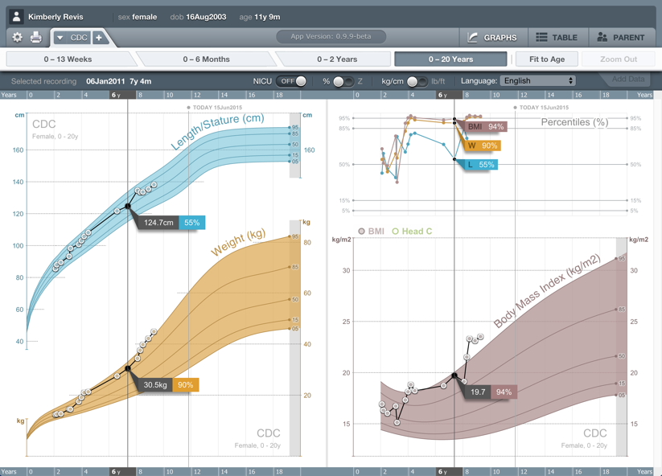
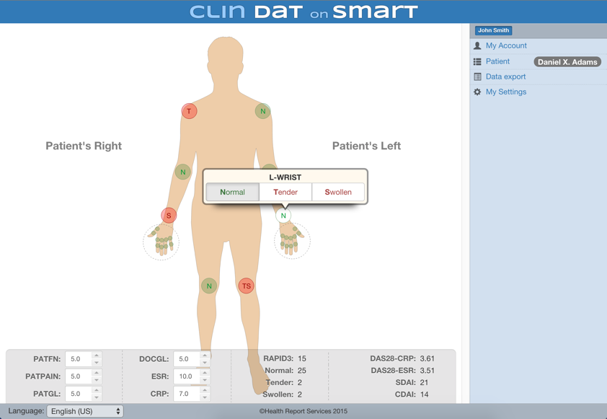

SMART Health IT
Healthcare Apps
Clinical Systems
(EHRs, Patient Portals, Data Warehouses)
SMART:
UX Integration
Authorization
Single Sign-On
Clinical Data

Slide 16
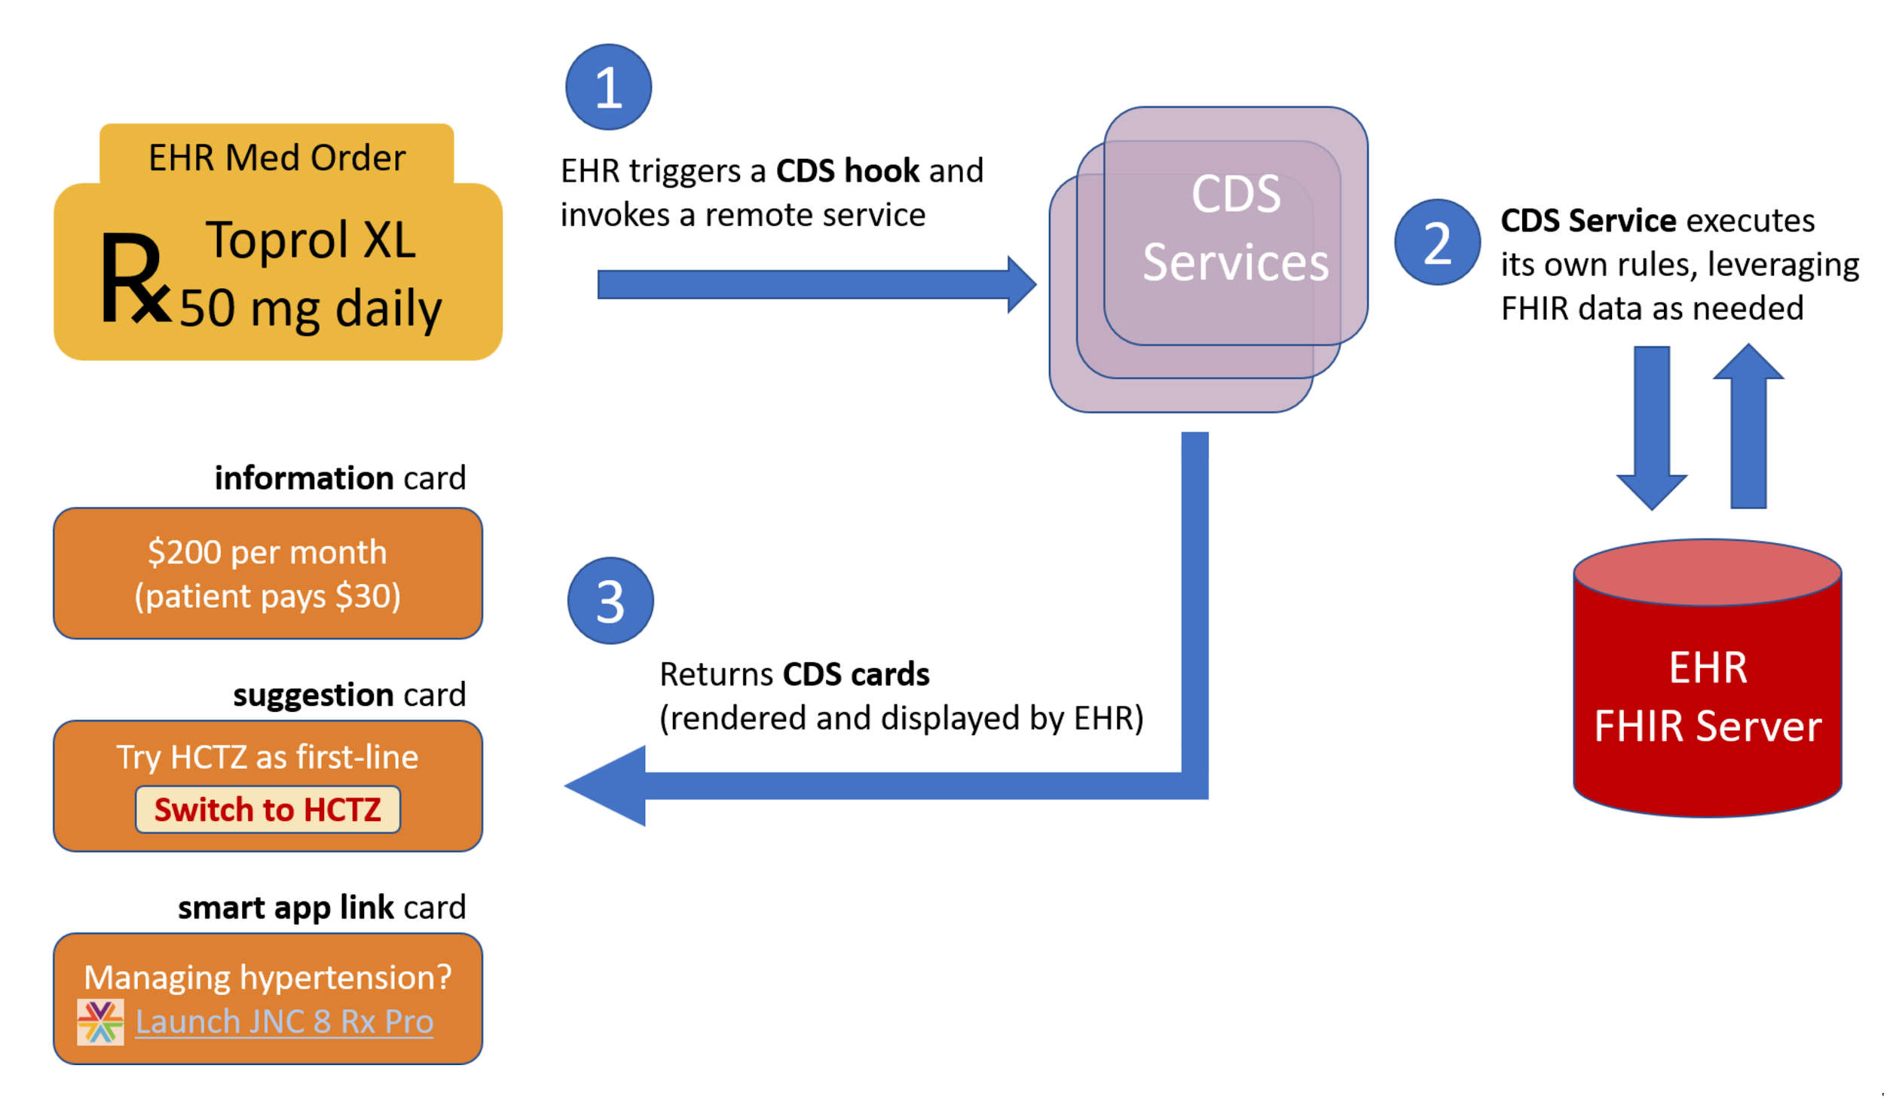
CDS Hooks

Slide 17
An ecosystem of FHIR and related technologies
NLP: clinical notes → FHIR
FHIR-based personal records
FHIR Appointments
SMART on FHIR
Bulk Data
CQL, Quality Measures
FHIR Subscription (public health)
(disease registries)
CDS Hooks
FHIR Clinical Reasoning
FHIR Questionnaires
FHIR Plan Definitions, Orders
SMART on FHIR
Machine reading of literature
FHIR Evidence, Measure, MeasureReport
FHIR trial match (e.g., ResearchStudy, inclusion criteria)

Slide 18
Спасибо⁠—Q&A?

